Slide 1
GTÜ CSE 495 and 496 Striker
BIL 495
Second Presentation
Derviş Ali Duman
Proje Danışmanı: Dr. Alp Arslan BAYRAKÇI
December 2022

Slide 2
Content
Image Processing
HSV Tracker
Shooting Mechanism
What I have done
Challenges that I faced

Slide 3
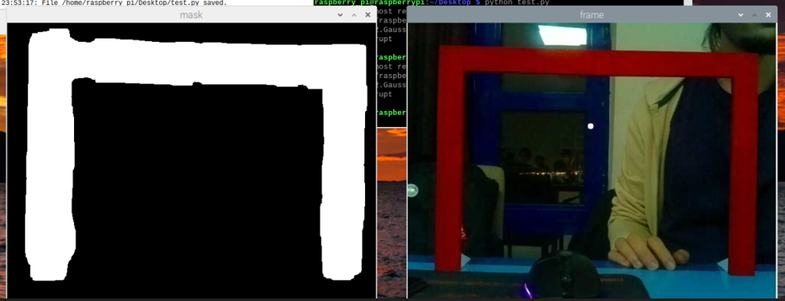
Image Processing
I blurred image then reformatted image BGR to HSV.
For the color mask, it needs HSV values. So, I used HSV tracker for the right range of color.
There is white spaces when we applied a mask in that specific color detected places.
Lastly found contours for finding biggest white space and it’s center.

Slide 4
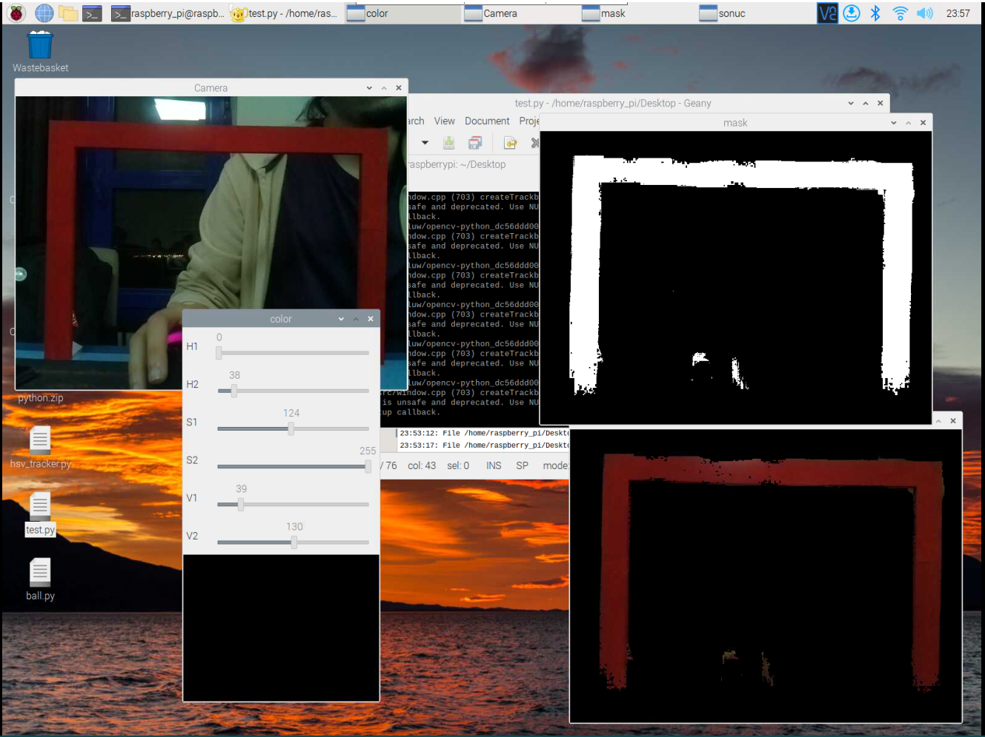
HSV Tracker

Slide 5
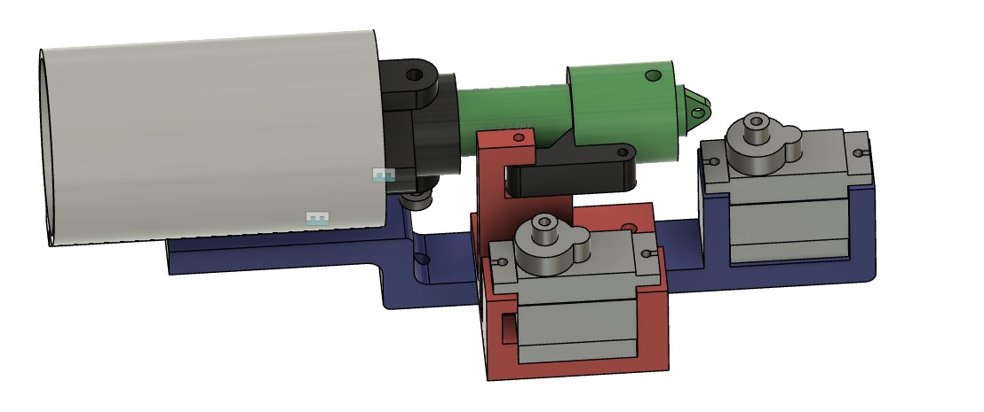
Shooting Mechanism

Slide 6
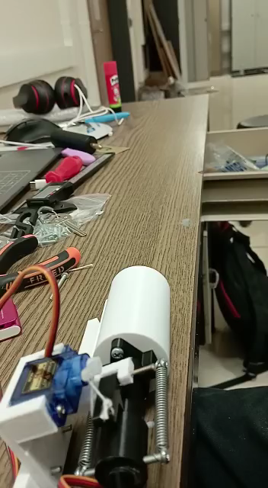
Shooting Mechanism

Slide 7
What I’ve done
Done:
Drawing the baseline of the robot.
Designing and 3D printing the shooting mechanism.
Taking some pictures from the camera connected to robot.
Detecting soccer goal and ball images.
Finding the middle of the goal.
Mechanism can shoot the ball.
Finding new ball for more accurate shots.

Slide 8
To-Do
To Do:
Making sure the robot can detect if it was a score or not.
Shooting mechanism should have more power.
Adding more hardware like motor driver.
Adding different hit powers and angles.
Stabilizing the shooting mechanism if everything is okay for the machine learning.
Train the machine for more accurate shots for different angles and different distance.

Slide 9
Challenges that I faced
As the lighting changes, it can be difficult to detect the football goal and ball.
Raspberry pi is not a powerful machine so I can’t make complex algorithms.
Different springs causes different effects, I need to choose the most optimal spring. I need more R&D.
I tried different balls (ping pong, marble, aluminum) at the and I chose the pinball.
Shoting system has not enough power.

Slide 10
Resources
https://opencv.org

